Slide 1
Deanonymizing Quora Answers
Arunika Yadav :1601CS56
Harshika :1601CS14

Slide 2
Introduction :
Authorship identification has been a very important and practical problem in Natural Language Processing. The problem is to identify the author of a document from a given list of possible authors.It enables us to identify the most likely author of articles, news or messages. Authorship identification can be applied to tasks such as identifying anonymous author, detecting plagiarism or finding ghost writer. We have solved the problem of deanonymizing quora answers using the different techniques of authorship identification which are available and also study a combination of models to improve the accuracy.

Slide 3
Background:
Analysis of authorship of historical texts has already been done many times using techniques for authorship attribution.
Various spoofing emails can also be detected by using these techniques.
We are trying to apply our knowledge of authorship attribution to our project

Slide 4
Innovation :
Quora, currently, does not have a system to deanonymize it’s answers.Hence it is vulnerable to cyber crime, plagiarism and other such content related crime.Thus,in order to curb the anonymity of answers and offer a better experience to the users we offer this solution.

Slide 5
Our Model :
It is a supervised learning task as a label is present for each of the training examples. Since there are multiple authors and we have to assign the document just one of them, it is also a multi-class single label text categorization problem.
We basically used the following models for accomplishing our tasks: naive bayes classifier, support vector machine classifier, decision classifier, random forest classifier, logistic regression classifier, stylometric features or style markers and convolutional neural networks.
Similar ideas have been tried out in the past but not necessarily in this particular combination. We have used Python programming language for implementing our model. We have used logistic regression classifier from the Python SciKit Learn library.We have also used keras library for implementing neural networks.

Slide 6
WORK FLOW:
Data Set Collected :
Quora (From Kaggle.com):
Collected 50 answers of 50 authors each
Top writer’s answers of same topic
Split the dataset into 8:2 ratio(train : test)
2. Data Preprocessing:
Importing the dataset in the form of text file itself (unlike the regular way of importing it in the form of .csv file using the panda library).
Replaced all the ‘newline’ characters with a space in order to make the full answer as a whole chunk of words rather .
CLEANING the Data: removing punctuations , converting into lower case , removing the stop words, stemming
Joining the answers of one particular author to form a list of words

Slide 7
Bag of Words Model:
The bag-of-words model is one of the feature extraction algorithms for text. It ignores grammar and order of words.
We defined a collection of strings called a corpus.Then we used the CountVectorizer to create vectors from the corpus(collection of strings).
The number of elements in the feature vector is called the dimension.
This made the data ideal for splitting the dataset into a ratio of 8:2 to be taken as the training data and test data respectively.
In addition we also tried using tf-idf vectorizers for feature extraction but it did not increase the accuracy as it produces very sparse matrix.

Slide 8
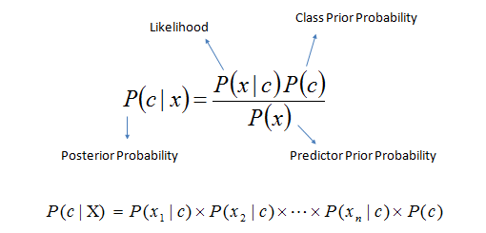
3. Naive Bayes Classifier :
The Naïve Bayes classifier attempts to simplify the problem by computing the probability of some value given the set of all attributes.
In our problem, given the words used in the document as attributes, by Bayes Theorem we calculated the probability of that document being written by a particular author .We obtained decent accuracy using this.

Slide 9
For each known class value (author) :
Calculate probabilities for each attribute (words), conditional on the class value.
Use the product rule to obtain a joint conditional probability for the attributes.
Use Bayes rule to derive conditional probabilities for the class variable.
Once this has been done for all class values, output the class with the highest probability.
Accuracy : 78.4%

Slide 10
Support Vector Machine (SVM)::
Support Vector Machine is a supervised machine learning algorithm which can be used for both classification or regression challenges.
However, it is mostly used in classification problems.
It is based on the concept of decision planes that define decision boundaries.
A decision plane is one that separates between a set of objects having different class memberships.
Accuracy : 83.49%

Slide 11
Decision Tree Classifier:
Decision Tree Classifier, repetitively divides the working area (plot) into sub part by identifying lines. The goal is to create a model that predicts the value of a target variable by learning simple decision rules inferred from the data features.
The decision tree algorithm tries to solve the problem, by using tree representation. Each internal node of the tree corresponds to an attribute, and each leaf node corresponds to a class label.
Accuracy : 52.5%

Slide 12
Random Forest:
A random forest is a estimator that fits a number of decision tree classifiers on various sub-samples of the dataset and use averaging to improve the predictive accuracy and control over-fitting.
It is an ensemble type of model, i.e, it works by implementing decision tree classifier model many times.
Accuracy : 63%

Slide 13
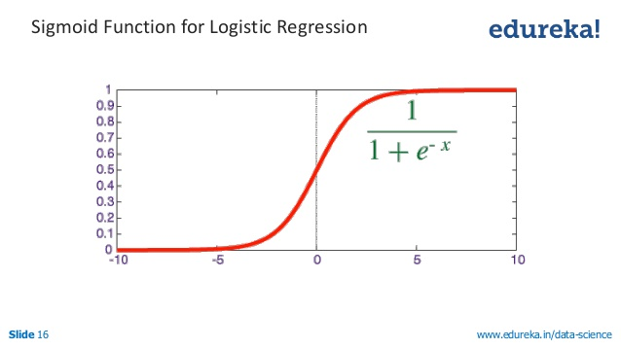
Logistic Regression:
Logistic regression is named for
the function used at the core of
the method, the logistic function.
where e is the base of the natural logarithms and value is the actual numerical value that you want to transform.
We used the NLTK library and the scikit learn library to implement the same and obtained the best accuracy so far.
Accuracy : 85.59%

Slide 14
Stylometric Features:
Stylometric features or style markers try to capture the writing style of the author. The features pertaining to types and token are:
number of types (unique words),number of tokens, type-token ratio.
as average length of a sentence (both in terms of words and characters),
standard deviation of sentence lengths.
relative number of declarative,interrogative, imperative and exclamatory sentences.
Other style markers include relative number of punctuations, relative number of digits in the document etc.
Natural Language Tool Kit (NLTK) has been used to extract these style markers from the text.

Slide 15
Other methods explored: CNN
We also tried CNN as they have been proved to be very effective for this problem in the literature. Implementation of CNN was done in keras.
The initial accuracies were not good. One problem that we suffered from was the lack of data. We had only 20 MBs of text, used for training and testing of 50 classes. Since neural networks require a large amount of data for getting appreciable results, they did not help in effectively solving our problem.
Therefore, we did not further consider the approach of using CNN for solving our problem.We tried to go for the larger dataset of size 1 GB but because it was not labelled, we could not proceed with the same as labelling it would have taken a lot of time.

Slide 16
Experimentation & Results:
We started out with the simple naive bayes classifier which gave a decent accuracy.
Then we tried various other classifier models of which logistic regression performed the best for us. So we decided to go ahead with it.
LOGISTIC REGRESSION plus STYLOMETRIC FEATURES gave us the best accuracy of 84 percent which could not even be achieved by implementing neural networks.

Slide 17
PROPOSED PLATFORM and VISUALIZATIONS :
We had also proposed to build a UI for our machine learning models but due to the format of our data we faced a lot of problem and had to give in a lot of time but we could not come up with a solution.The same issues with the visualisations.(future work….1).
Also better results could be obtained with neural networks with larger size dataset.We did have a 1 GB sized dataset but it was not labelled, hence we could

Slide 18
CONCLUSION
The accuracy obtained by our model is close to the accuracy of the baseline
model from one of the references that we were using.
This shows that stylometric features are crucial to the task of identifying
the anonymous authors. Also for the used dataset, traditional classifiers like
naive Bayes, SVM and logistic regres- sion are performing better than neural
network models like CNN.

Slide 19
THANK YOU

